Slide 1
1. Log in to KLAS Information Service and click the menu button
(2022.02.25)

Slide 2
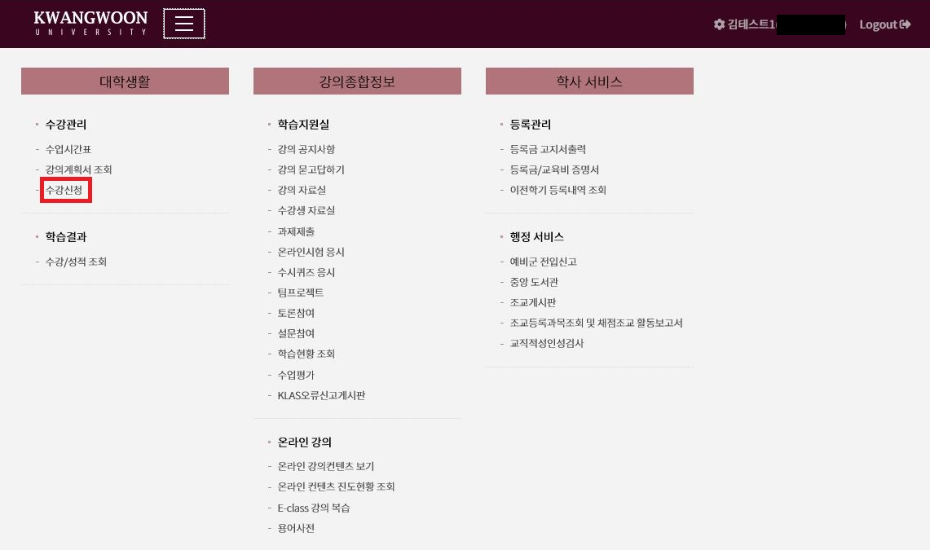
2. Click on “Course Sign-up” on the left under University Life

Slide 3
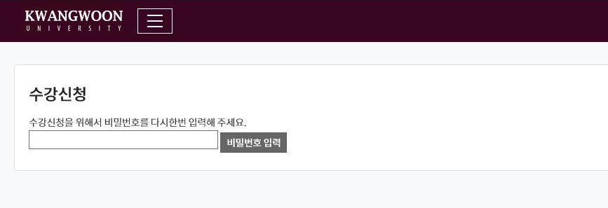
3. To sign-up courses, input your password of KLAS Information Service again

Slide 4
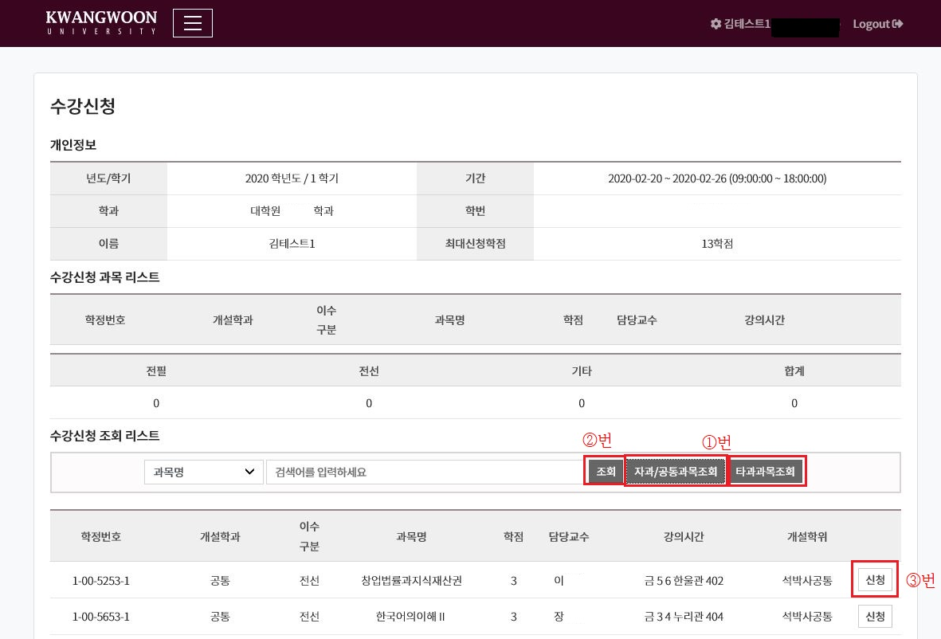
4. In the course list under the Course Sign-up screen, ① selecting ‘Inquiry for a course (your department)/common courses’ or ‘Search for other courses,’ ② clicking Search, and find the course you want to sign up, then ③ click ‘Sign-up’ to take the course
2022학년도 / 1학기
2022-02-24 ~ 2022-02-26 (09:00:00 ~ 18:00:00)

Slide 5
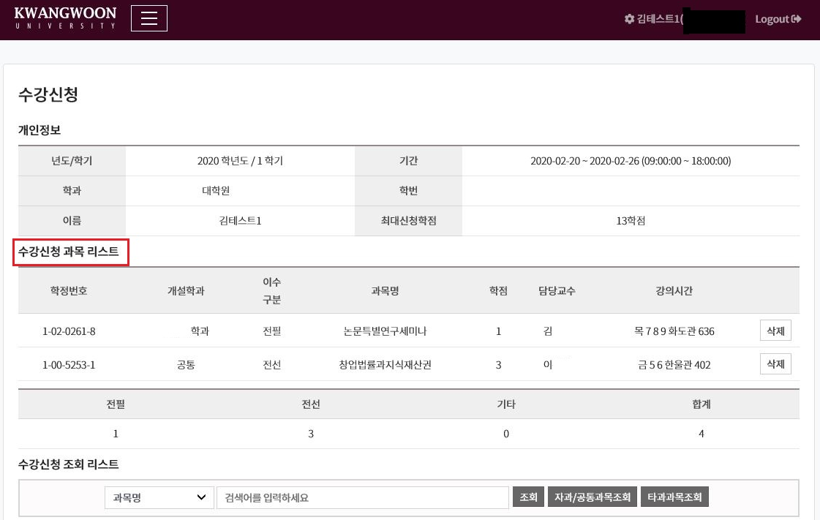
5. You can check the courses you signed up at the “Your Course List”
2022학년도 / 1학기
2022-02-24 ~ 2022-02-26 (09:00:00 ~ 18:00:00)

Slide 6
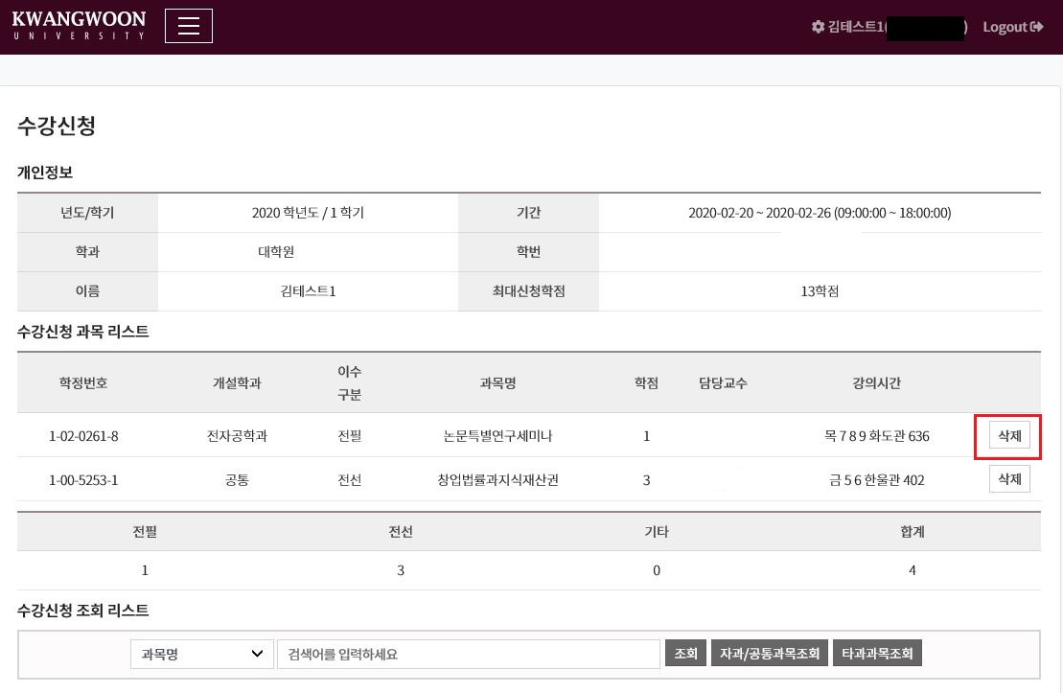
6. If you want to delete a course, click “Delete” from Your Course List.
2022학년도 / 1학기
2022-02-24 ~ 2022-02-26 (09:00:00 ~ 18:00:00)

